Slide 1
Molecular Motors, continued
Steven Gross
Last time:
Overview of motors
how to get down to single-molecule level: Dilution plus Poisson Distribution

Slide 2
What does the mechanical processivity tell us about the enzymatic processivity?
Next, will see that stepsize=8nm.
Then, 800/8=100, so on avg goes through approximately 100 enzymatic cycles before releasing MT. This corresponds to ~1% probability of MT release at each enzymatic cycle.

Slide 3
Does it take discrete steps, or move continuously? If steps, what size?
MT built of repeating subunits (dimers). Each dimer is 8 nm in length
If moves along a single protofilament, expect steps that are some multiple of 8nm. If lateral steps possible, could take smaller steps.

Slide 4
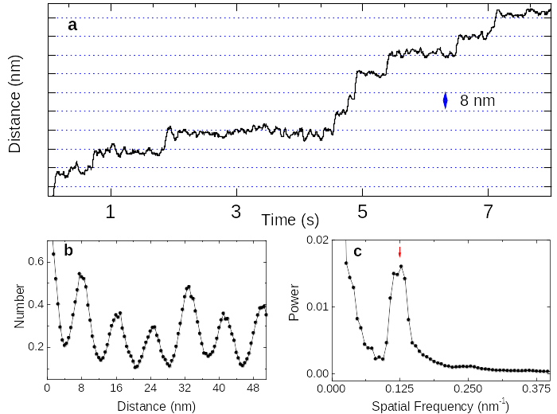
Single-molecule driven beads move in 8 nm steps at low [ATP], low load

Slide 5
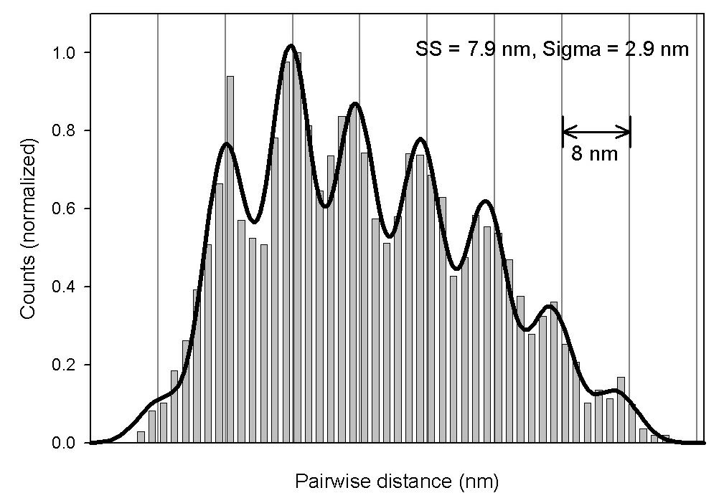
Extraction of Step size from displacement records
Pairwise Distance
Function analysis
Position
Step
Size ?
Time
You expect to see regular peaks in a histogram of such pairwise distance at multiples of the Step size

Slide 6
Conclusion so far…
Kinesin goes on average ~ 1 micron before falling off MT
Decaying exponential distribution→ many short ‘runs’, a few long ‘runs’
How do we determine kinesin’s mean travel from single-molecule measurements?
How accurate is our estimate?
How many measurements do we need?

Slide 7
Statistics: a crash course
A ‘mean’ is usually indicated with a Confidence Interval
A confidence interval has two parts:
1) An estimate of the value of the parameter (e.g. the mean), given as
a) two endpoints of an interval (e.g. 114 to 126)
or
b) mean ± margin of error (e.g 120 ± 6)
2) A confidence level that indicates the probability that the actual value falls within the indicated interval

Slide 8
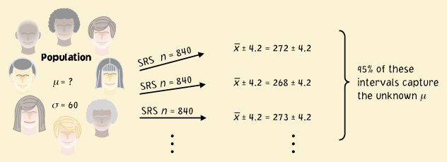

Intuitive meaning of a confidence interval
Estimate a mean value of distribution, µ:
‘ ± 4.2 is a 95% confidence interval for μ’
Signifies that in 95% of the cases, the actual value of μ will be within 4.2 units of the value of .

Slide 9
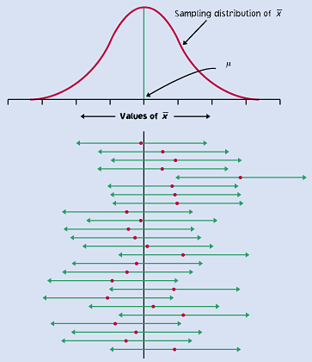
Illustration of multiple repeated samples
Red dot: mean value
of individual sample

Slide 10
How can we confirm that our estimate of a confidence interval is correct?
Do a simulation where you KNOW what the underlying mean is, see whether your process ends up generating CIs which correctly include the actual mean, the approximate right percentage of the time. E.g. if you thought you made a 90% CI, your CIs should include the correct mean in 9 out of 10 tries, approximately.
You will do this in the homework

Slide 11
How can we derive confidence intervals for our measurements?
Use the distribution of sample means.

Slide 12

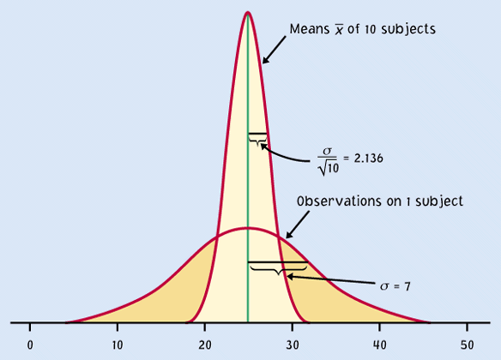
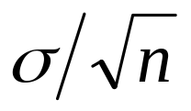

Distribution of sample means described by normal curve: significance
Sample distribution is
narrower than the population
distribution, by a factor of √n.
Estimates derived from
means of samples
relatively close to the
population parameter µ.
How close? Think in units
of the width of the distribution
n
(Population)
μ
Population: normally distributed N(µ,σ),
Sampling distribution N(µ,σ/√n).

Slide 13
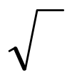
Key result:
population with standard deviation σ, samples of size n, then:
the distribution of the means around the actual mean value μ is described by a normal curve with standard deviation σ/ n.

Slide 14
Distribution of means is described by a normal curve: significance
The curve is a probability model and tells us how likely different observations are
The probability of an event corresponds to the area under the curve
If you say that the mean will be found in a particular range of values 95% of the time, that range of values must account for 95% of the area of the curve.

Slide 15
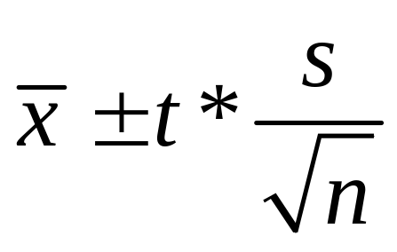

In practice: how to determine a t-based confidence interval
The formula for the confidence interval is:
Where is the sample mean, s is the calculated standard deviation, n is the number of items in the sample that were used to calculate s, and t* is a numerical value chosen based on the desired confidence, and taking into account the degrees of freedom (n-1).

Slide 16
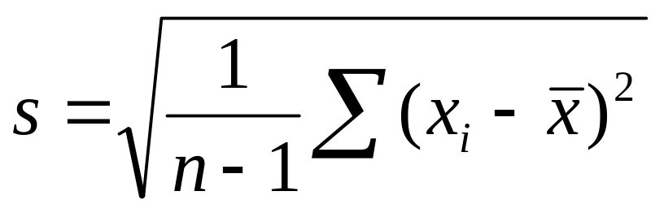
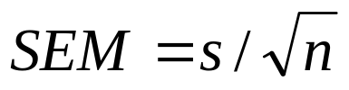
Standard deviation and Standard error of the Mean
Start by estimating the standard deviation. The actual std deviation is σ, but we don’t know it. We estimate it, and call it s.
s is:

Slide 17
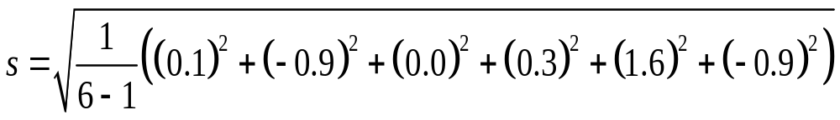
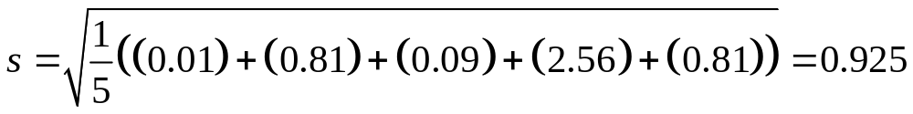
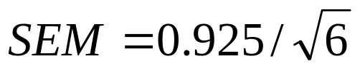
Example: finding s
Example: Catch 6 trout, measure lengths. Find:
{6.1, 5.3, 6.2, 6.5, 7.8, 5.3}
(Mean = 6.2)

Slide 18
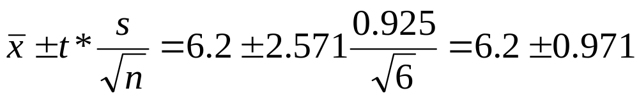
Example: ctd: find a 95% CI
{6.1, 5.3, 6.2, 6.5, 7.8, 5.3}
(Mean = 6.2)
95% CI is:
t* was t value for 95% confidence level, and df = 5 (n-1)

Slide 19
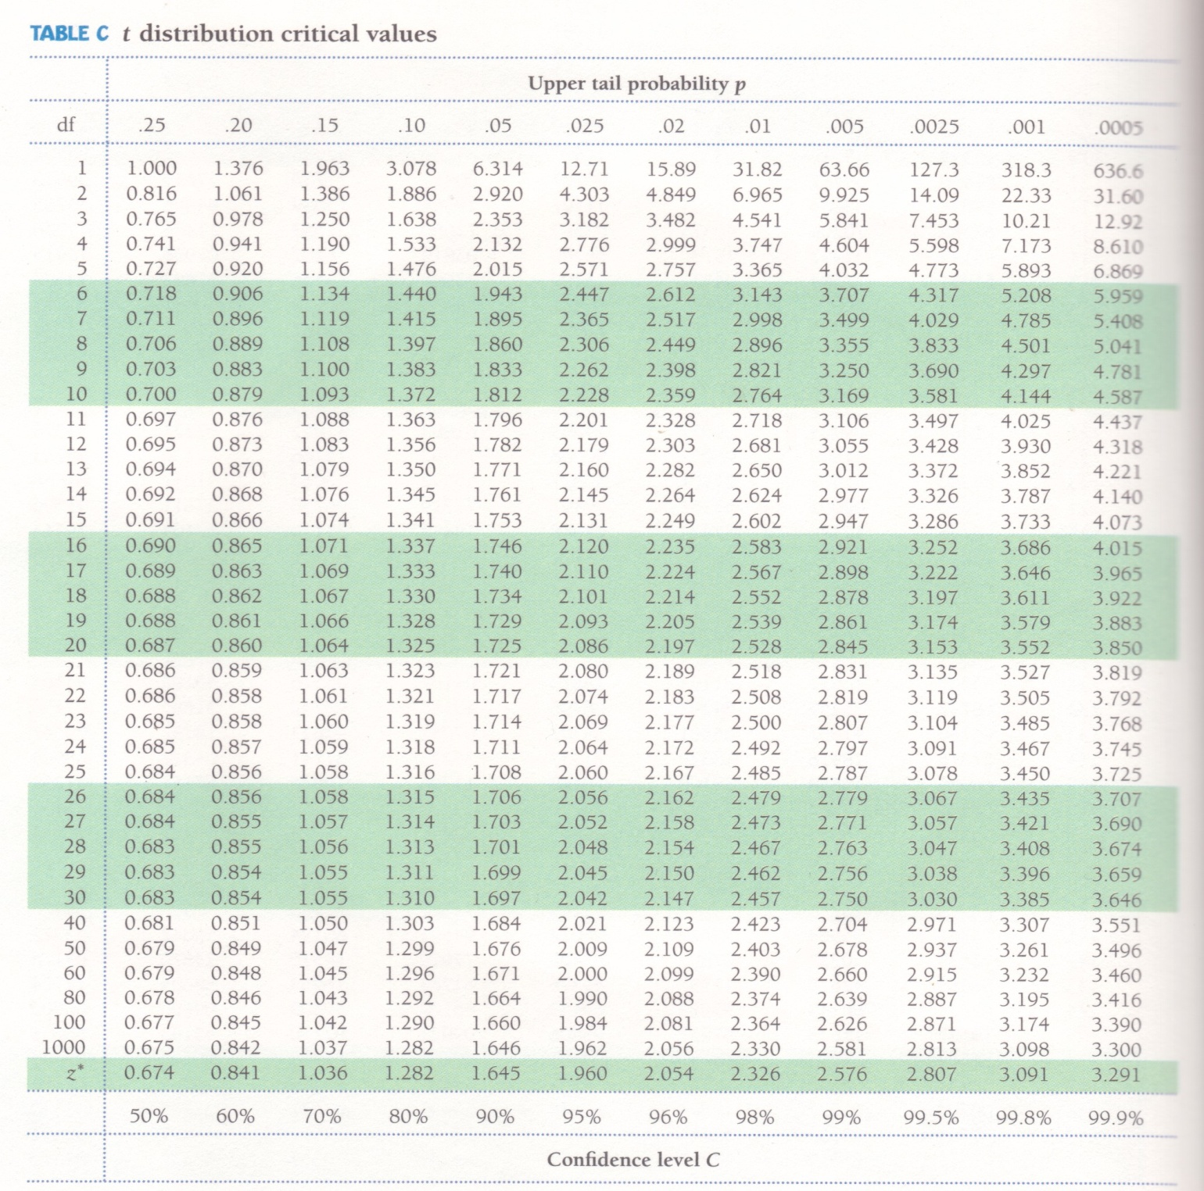
Use of table C

Slide 20
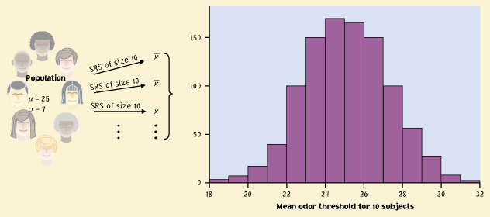
Underlying assumption: the Sampling distribution is normally distributed
It is a distribution made by taking repeated (small) samples from the population, and displaying the the results as a histogram.

Slide 21
Example-trout sampling distributions
Make 36 random measurements:
{7.5, 5.5, 6.5, 7.3, 6.6, 8.0, 5.4, 4.9, 3.8, 7.2, 6.9, 9.2, 5.7, 5.9, 6.2, 3.6, 2.3, 6.9, 5.4, 3.2, 2.6, 7.6, 6.1, 4.7, 5.1, 9.9, 5.0, 4.3, 8.7, 4.1, 5.3, 5.8 ,5.6 , 8.1, 6.7, 6.1}
Suppose these had been successive SRS of size 2: {6.5, 6.9, 7.3, 5.2, 5.5, 8.05, 5.8, 4.9, 4.6, 4.3, 5.1, 5.4, 7.5, 4.65, 6.4, 5.55, 6.85, 6.4}
Suppose these has been successive SRS of size 4:
{6.7, 6.25, 6.78, 5.35, 4.45, 5.25, 6.08, 5.98, 6.63}
So, as the size of the SRS goes up, the variation goes down

Slide 22
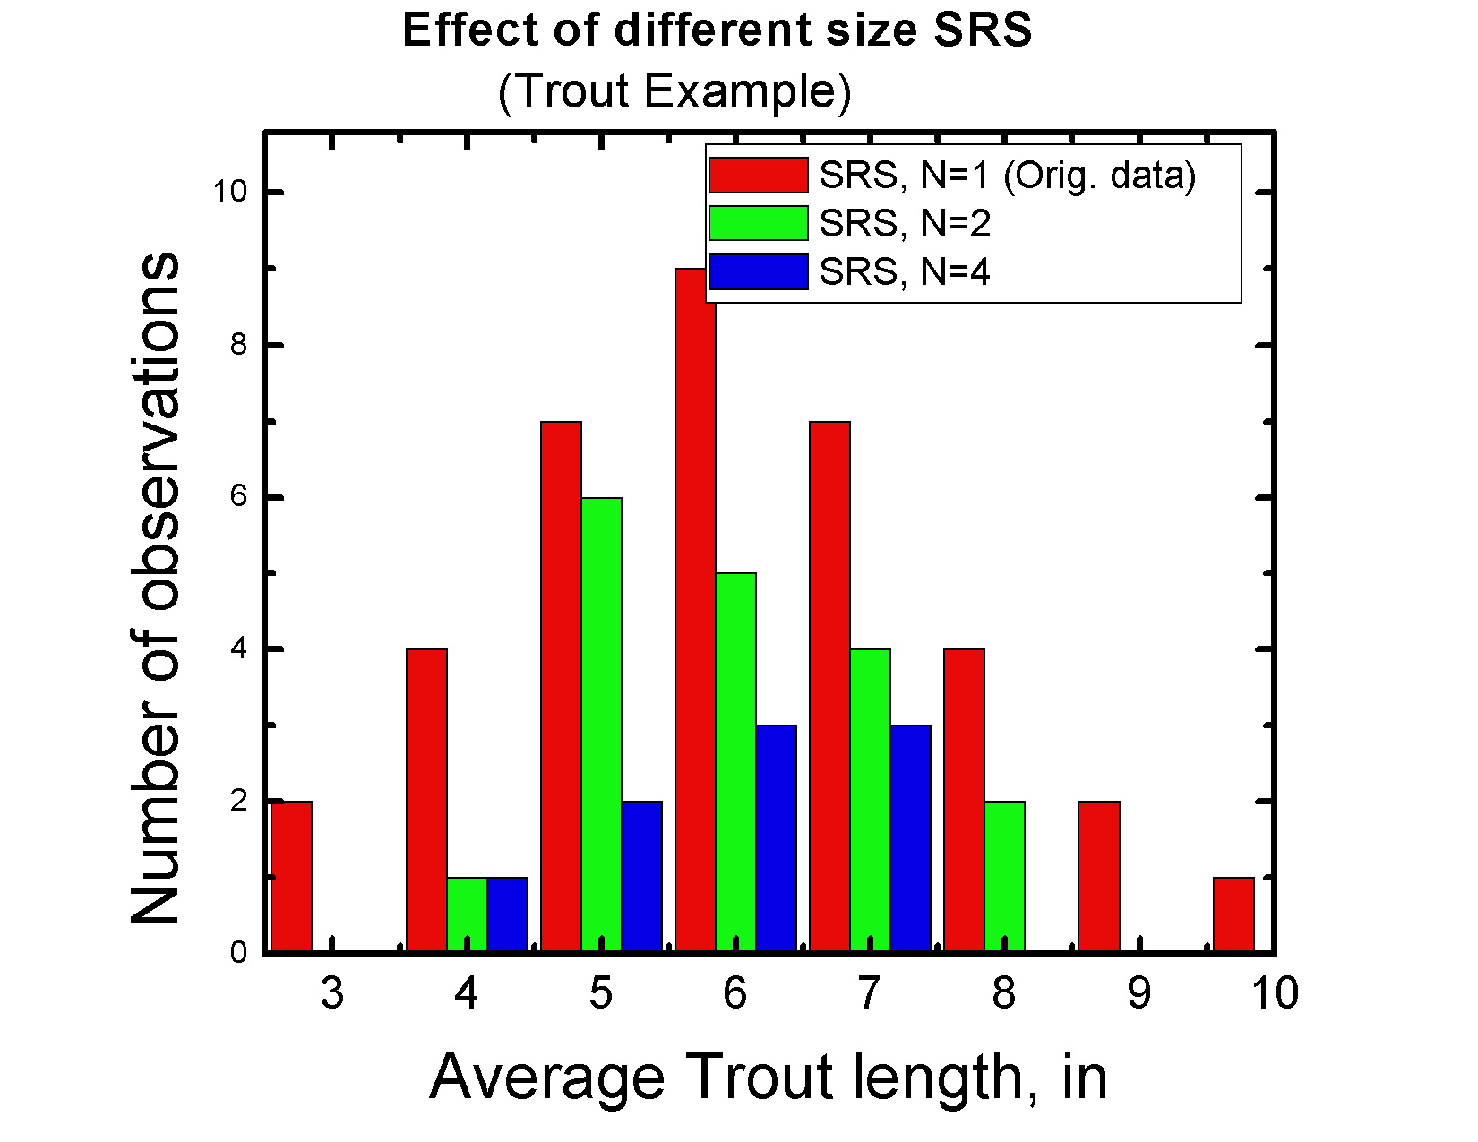

Slide 23
The width of the sampling distribution depends on the size of the SRS

Slide 24
t-tests: one versus 2-sided tests
To do a t-test, need to decide if it is a ‘1-sided’ or 2-sided test.
Which you do depends on a priori knowledge: if no such knowledge, simply asking if two sets of measurments reflect different underlying populations→ 2-sided
if have independent reason to think 1 population larger or smaller than the second→ 1-sided

Slide 25
Doing a t-test
Suppose you compare these trout to trout from a river, where the mean length is known to be 8 inches. Are these trout differently sized? (with a Mean = 6.2 inches)
(t* below is t value for 95% confidence level, and df = 5 (n-1))
Since 8 inches is not in the Confidence interval, they are different.

Slide 26
Use of table C

Slide 27
Standard deviation and Standard error of the Mean
Start by estimating the standard deviation. The actual std deviation is σ, but we don’t know it. We estimate it, and call it s.
s is:
In general, when presenting avg of experimental data, write mean +/- SEM

Slide 28
Key point: if the underlying distribution is normal, then so are sampling distributions of any size
In this case, t-based CI works for any size sample
What if data is NOT distributed normally?

Slide 29
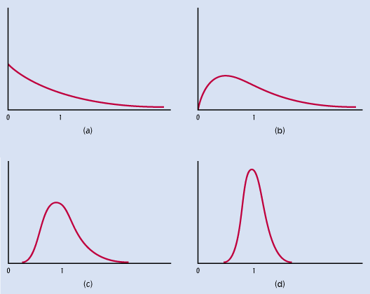
Central Limit Theorem saves us, eventually
Distr. of 1 observation
Distr. for avg. of 2 observations
Distr. for avg. of 10 observations
Distr. for avg. of 25 observations
In your hw, you are to figure out empirically how big the sample size must be for the t-based CI to work

Slide 30
Summary: Statistics:
A confidence interval has two parts:
1) An estimate of the value of the parameter (e.g. the mean), given as
a) two endpoints of an interval (e.g. 114 to 126)
or
b) mean ± margin of error (e.g 120 ± 6)
2) A confidence level that indicates the probability that the actual value falls within the indicated interval

Slide 31
In practice: how to determine a t-based confidence interval
The formula for the confidence interval is:
Where is the sample mean, s is the calculated standard deviation, n is the number of items in the sample that were used to calculate s, and t* is a numerical value chosen based on the desired confidence, and taking into account the degrees of freedom (n-1).

Slide 32
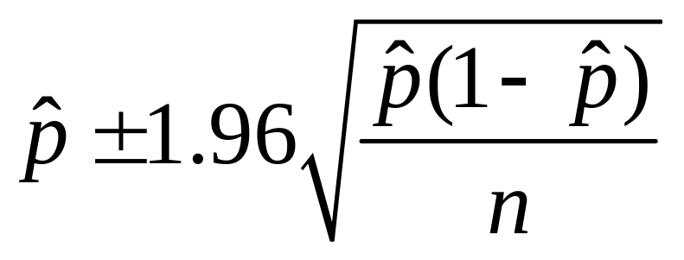

Proportions: how to determine a confidence interval for an estimated proportion
The formula for a 95% confidence interval is:
Where is the estimate proportion, n is the total number of observations in the sample that were used to calculate .

Slide 33
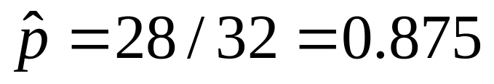
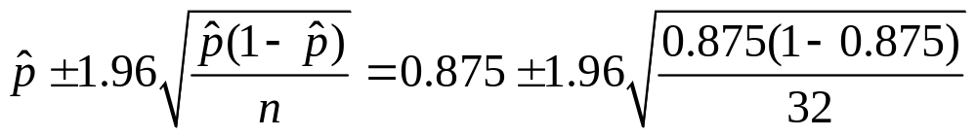
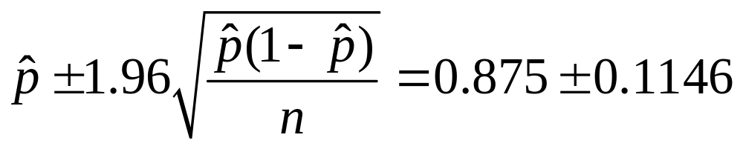
Example, proportions
Suppose expose flies to bacteria, inject all, and 4 of 32 survive. What is your estimate of the proportion of flies that die?
Thus, 87.5% +/- 11.5% are estimated to die (95% CI)

Slide 34
t-tests and confidence intervals
Once you have calculated t, use table C.
Must keep track of the ‘degrees of freedom’. This is indicated by df, to the right.
For the one-sample t-statistic, the degrees of freedom is n-1.

Slide 35
Summary
With this basic introduction to statistics, you now know enough to do most of what you need for basic research.
In my lectures, will use this to establish the mean travel of the motor in your simulation, and to determine how putting two such motors together changes the mean travel.

Slide 36
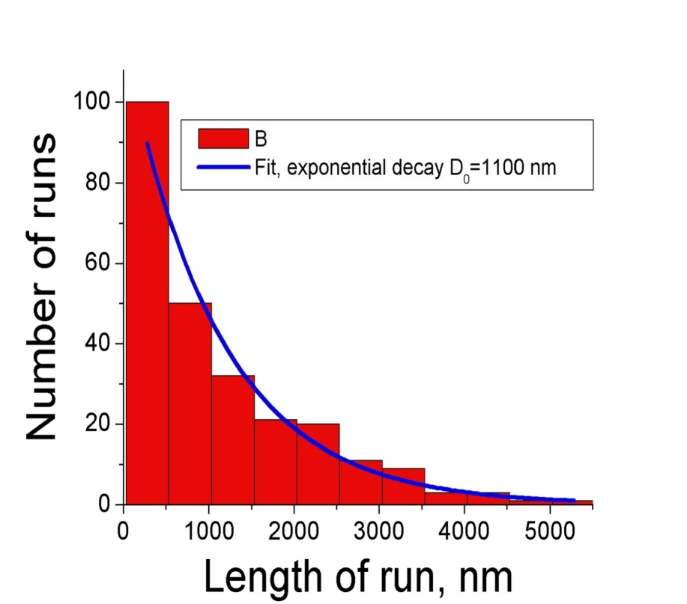
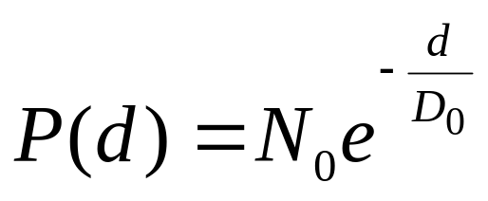
Processivity and Decaying-exponential distributions
The fact that the distribution is described by a single decaying exponential
suggests that a single random process ends runs
Mean run length ~1000 nm

Slide 37
More on decaying exponentials
In our case, k=1/D₀, where D₀ is the decay length
For a decaying exponential, the mean of the distribution IS the decay length, which means that not only is 1000 nm the decay length of the exponential for kinesin, it is also the mean kinesin run length
Conclusion: a single random process results in the motor letting go from the MT; a decaying exponential distribution reflects ONE dominant detachment rate-determining step

Slide 38
Homework, #1 (worth 15 points, due finals week, by the time the class final is given):
A. Simulate a single kinesin-type motor stepping along a microtubule (MT). At t=0 (the start of a ‘run’) it should attach to a microtubule. At each subsequent timestep it should have a probability of stepping, or falling off the MT (which ends the run). Each successful step should advance it 8 nm. You should adjust the stepping frequency so that the average velocity is 800 nm/sec, and should adjust the off rate (probability of falling off the MT for a given step) so that the mean travel distance is 800 nm. Important: the ‘timestep’ of the simulation should be relatively small compared to the frequency of stepping, so on many ‘iterations’ of the simulation there will be no step; the probability of a step must be the same on each iteration.
B. Simulate different numbers of trials(e.g. 10, 20, 40, 80, 160, 1000 individual ‘runs’) and make corresponding histograms showing the distribution of run lengths.

Slide 39
Homework, #1 (worth 15 points, due finals week):
C. Determine what sample size is required for reasonable estimate of the distribution’s properties. First, confirm that your simulation is working correctly—generate a really large number of runs (eg 10,000, and confirm that the mean travel is about 800 nm. If not, there is a problem in your simulation). Next, for each choice of sample size from B, generate many samples of that size, and determine a 95% CI (using standard t-test approach discussed in class) and for each sample determine whether the calculated CI contains the actual mean of the population (which you know to be 800 nm, by construction). Then, for that sample size, determine the proportion of correct events, i.e. the number of tests that included 800, divided by the total number of tests. Plot a graph of the proportion, as a function of the number of elements in the sample. At some point (i.e. for some sample size N), the proportion should get close to 0.95. When is that?
Finally, for each sample size, use the statistic we discussed in class (on proportions) : for each sample size, does the 95% CI include 0.95?
Although I originally suggested a few different sample sizes (in B), feel free to go beyond those sizes as you see fit.
From all of this, summarize what you have learned about sample size, t-tests, and skewed distributions.

Slide 40
Homework: Simulate a motor walking
Steps in simulation:
Check if bound (bound =true?)
If bound=true→ continue to 3, otherwise end ‘run’, determine how many steps were taken by looking at counter.
Check if tries to step (probability check)
if tries to step either
a) falls off (decide which with a second
b) steps probability check)
4. If steps→ increment step counter
5. If falls off→ set bound =false.
Each such set of steps simulates a single walking motor. Repeat many times to get a distribution of ‘runs’

Slide 41
Homework, #1 (hints):
Key point in simulation: size of timestep, and probability at each attempt.
Suppose that you know that kinesin takes 8nm steps, and on average goes 800 nm/sec. That means approx. 100 steps/sec.
Can you do a simulation, with time steps of 1/100th of a sec.?
(NO!!)
Suppose timestep = 1/10000 sec. What is the probability of stepping in any given timestep?
Hint: if 1/10000 sec is the timestep(ts), then 10000 ts/sec, and to get the correct average velocity, 100 of them should turn into actual steps. (P)*10000=100→ p = 100/10000=1/100, i.e. at any single time step there is a 1 in 100 chance of stepping, and a 99/100 chance of doing nothing.

Slide 42
What should a histogram look like?
Key choice: bin-size
(for a variety of rules for bin-size choice, see:http://en.wikipedia.org/wiki/Histogram)
How should bins be chosen?
If too big, all ‘the action’ is in one or two bins; that’s no good
If too small, not enough counts per bin—should have at least 5 counts in most bins
I will take off points if the histograms are not reasonable, as far as bin-size, and appropriately labeled

Slide 43
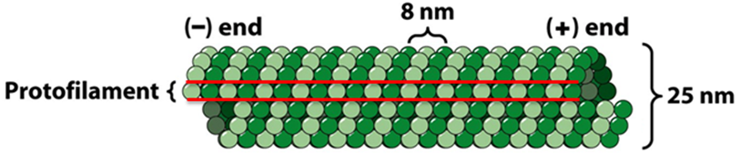
What does the mechanical processivity tell us about the enzymatic processivity?
Saw that stepsize=8nm.
Then, 800/8=100, so on average kinesin goes through approximately 100 enzymatic cycles before releasing MT. This corresponds to ~1% probability of MT release at each enzymatic cycle.

Slide 44
To better model kinesin, would like to investigate kinesin’s mechano-chemistry: how does it hydrolyze ATP--> ADP, and use the energy in the phosphate bond to do work?

Slide 45
Question #1: what controls how fast the motor moves under different conditions?
Answer: consider it as an enzyme; it is described by Michaelis-Menten kinetics
Enzymes are efficient and selective biological catalysts, that accelerate the chemical reaction towards equilibrium. Enzymatic rates are 10³ to 10¹⁷ times faster than the corresponding uncatalyzed reactions.

Slide 46
Enzyme kinetics, #1
Enzymes possess specific 3-D configurations that are fundamental to their biological function: the overall shape of the molecule stabilizes the shape of the ‘active site’
The ‘active site’ is where the substrate is converted to product.
The ‘active site’ stabilizes the transition state between the substrate and its product, thus lowering the activation energy for the reaction.
Decreasing activ. Energy by 34 kJ mol⁻¹ leads to a million-fold increase in the rate of reaction at 298 deg. K.

Slide 47
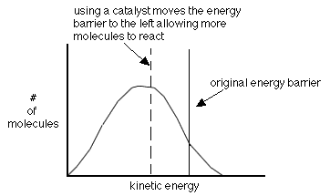
Catalyst lowers energy barrier

Slide 48
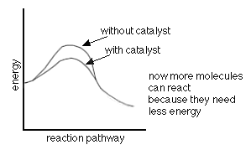
Different view: as the reaction progresses

Slide 49
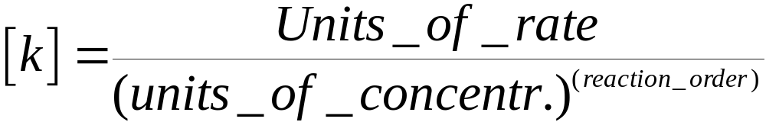
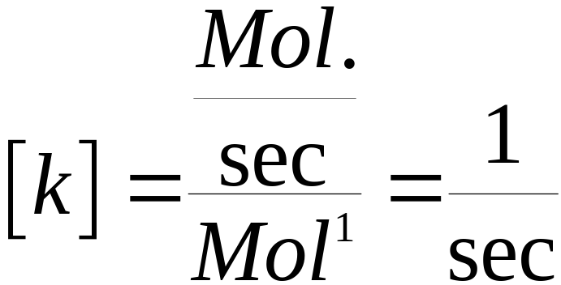
Enzyme kinetics #2:
How likely is a molecule to make it over the energy barrier?
The rate of the reaction is given by the rate constant, k, which has units:
Example: first order:

Slide 50
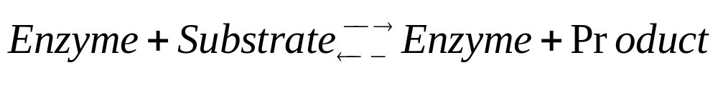
What does it mean for a reaction to be “first order”?
Suppose we imagine the reaction scheme:
If 1 enzyme smashes into 1 substrate molecule and reacts, the reaction is first order for each
If unexpected intermediates are required (e.g. temporary complex of 2 enzyme molecules) can have higher order reactions

Slide 51
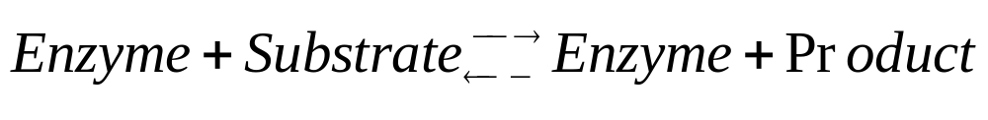
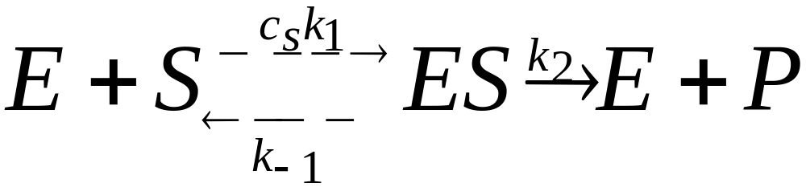
The molecular motor as an enzyme
Enzyme (E): motor; Substrate(S): ATP; Product(P): ADP
For enzymes, there is an unstable complex between enzyme and substrate. We represent this:

Slide 52
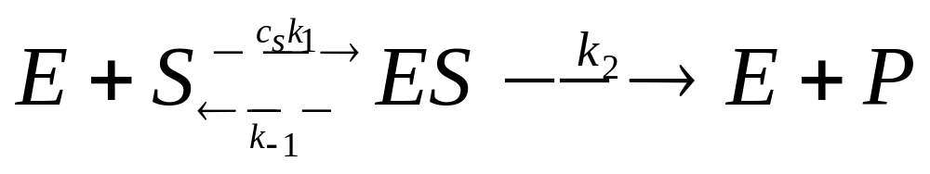
Motor as Enzyme, ctd. (#2)
C_{s} is concentration of S
k₁ is rate of rxn given a collision between E and S
There is no concentration for E; considering single motor molecule
k₋₁ is rate of complex falling apart and
k₂ is rate of reaction progressing

Slide 53

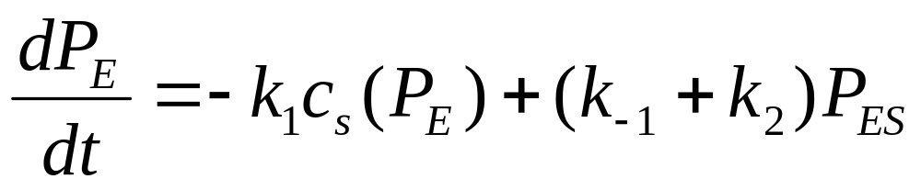
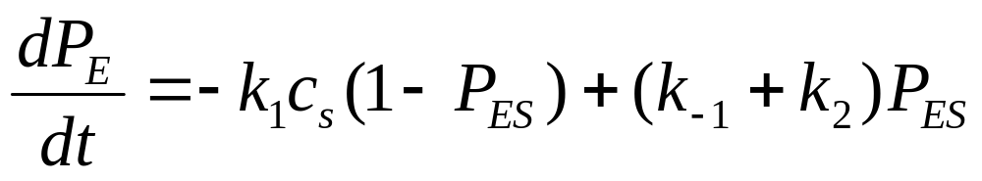

Motor as enzyme, (#3)
In a short interval of time, dt, the probability P_{E} to be in the state E can change in one of 3 ways:
If starts in unbound state E, has prob/unit time k₁c_{s} of binding S and leaving state E
If initially in enz-substr. Complex ES, has prob/unit time k₂ of processing substrate and releasing product, thus re-entering state E
ES can fall apart with prob./unit time k₋₁, and then Enz. Reenters state E.

Slide 54
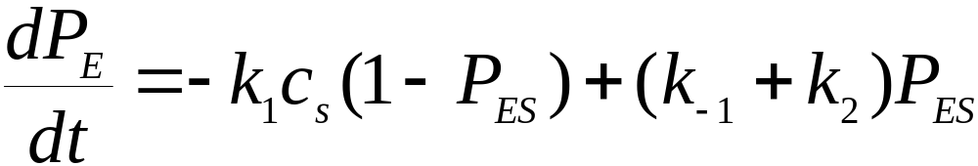
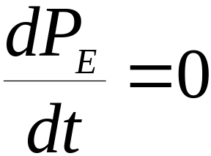
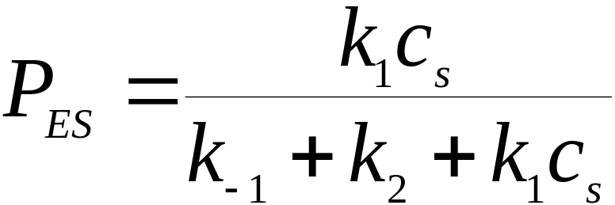

Motor as enzyme, #4
Quasi-steady state, so no change in time. Set
Solve for P_{ES}. Find:
Remember rxn is: but originally only
considering one enzyme E. Actual rate ‘velocity’ of producing product is V= (# ES complexes * k₂)=(c_{e}*P_{ES}* k₂)

Slide 55
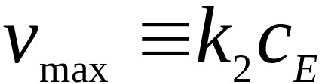
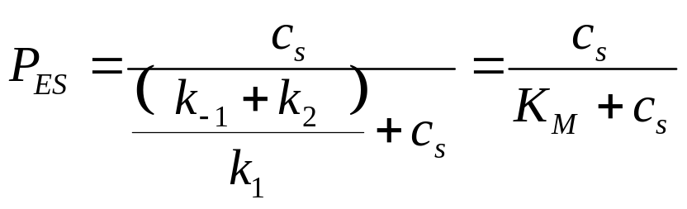
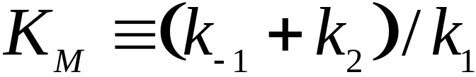
Motor as enzyme, #5
V= (# ES complexes * k₂)=(c_{e}*P_{ES}* k₂)
Maximum P_{ES}=1, so
Remember, found
Divide LHS by k₁/ k₁
With the Michaelis constant K_{M} defined as:
Note: K_{M} reflects competition between destruction of ES compex (on top) and creation of ES complex (below)

Slide 56
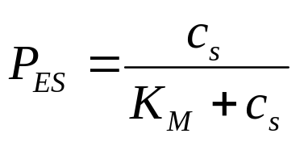
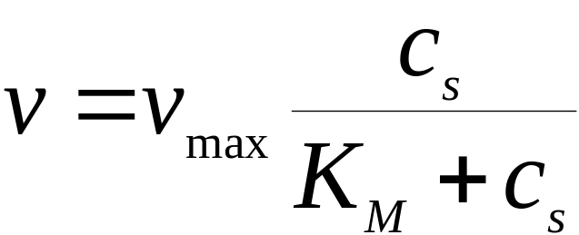
Motor as enzyme, #6
Remember V=(c_{e}*P_{ES}* k₂), so using and
We have
This is the Michaelis-Menten Rule.
Here, v is the velocity of the chemical reaction, i.e. how fast the motor converts ATP to ADP. It is NOT the velocity of the motor, as it depends on the number of motors present performing the ATP-->ADP conversions. C_{E} is the concentration of the motor.
It turns out, however, that this rule does in fact also describe the way a single motor works.

Slide 57
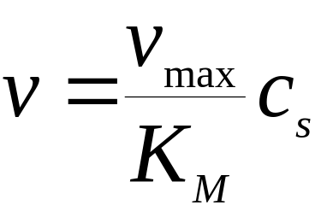

Motor as enzyme, #7
This Michaelis-Menton Rule displays saturation kinetics:
At low substrate concentration (i.e. c_{s} small) we can ignore the cs term in the denominator, and the reaction velocity is proportional to cs.
Then:
At higher substrate concentrations the delay exiting the intermediate ES complex (measured by k₂) starts limiting the reaction velocity; cant go faster than vmax.

Slide 58
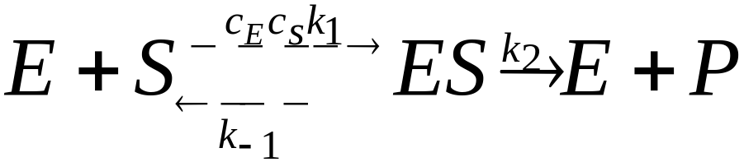
Observations
This Michaelis-Menton Rule describes bulk process, i.e. motor converting ATP to ADP
If we experimentally measure properties in solution, we can extract the properties of the single molecules. The maximum turnover rate of a single enzyme molecule is simply k₂, which is v_{max}/c_{E} Thus, if in solution we measure Vmax, and measure the motor concentration C_{E}, we can extract k₂ from ‘bulk’ measurements.
Meaning of K_{M}:
K_{M} is the ratio of the rate of destruction of the ES complex to formation of the ES complex. When C_{s}=K_{M}, the reaction velocity is half its maximum, so the relationship between Cs and K_{M} sets the reaction velocity. If the enzyme binds substrate rapidly relative to its catalysis rate and substr. dissociation rate, then k₁ is large, K_{M} is small, and even a low Cs will keep the enzyme fully occupied.

Slide 59
The Michaelis-Menten rule makes a testable prediction
We have predicted the dependence of v on c_{s}
(the only dependence on num. Of motors is in the prefactor, Vmax, so if consider a single motor, simply divide by a constant)
Lets test this prediction experimentally, on kinesin.

Slide 60
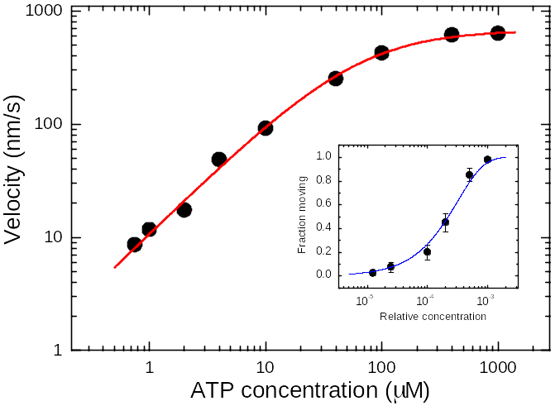
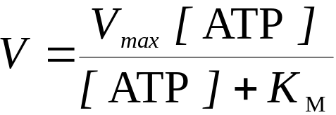



Single molecule velocity follows Michaelis-Menten kinetics

Slide 61
HW #2 (15 points):
Prob. #1 simulated a single kinesin stepping, ignoring load and ATP , by having “steps” occur with constant probability. You assumed kinesin takes 8 nm steps, with no back-steps, and has some probability of detaching per step, and tuned things to get the appropriate mean velocity and run-length. You made a histogram of run-lengths. Now we’ll look at velocities.
Q: how does velocity variation change with the size of the window used to calculate velocity? Show distributions
Q: Suppose a motor moves with a mean velocity of 800 nm/sec.
What is the chance of observing a velocity of at least 900 nm/sec at least once in a 1 second interval, calculating velocity over windows of 0.05 sec, 0.1 sec, 0.2 sec, 0.4 sec, and 1 sec?
Answer this same question for velocities of 1200 nm/s, 1600 nm/sec, 2400 nm/sec and 3600 nm/sec.
Explain how you got the answers.

Slide 62
Back to simulations…to understand how multiple motors work together, start with a model for one.
kinesin takes 8 nm steps, has a processivity of ~800 nm (100 steps), and velocity described by Michaelis-Menton kinetics
The MM kinetics suggest single rate-limiting step at saturating ATP. For single rate-limiting step, there is a constant probability per unit time of the event occurring→ distribution of times between steps is a decaying exponential.

Slide 63
Hw #3 (15 points):
The goal is to model two kinesin motors functioning together. In Hw #1 you developed a simulation for 1 motor. Here, you will stick two such motors together.
The main goal here: determine how changing the velocity of the motors (i.e. the rate at which each motor steps) affects the mean travel distance of the group, for two motors. You should compare these results to the order-of-magnitude theory developed in class. How similar are the two sets of predictions? If different, suggest what might account for the difference.
Assume that each individual motor has a processivity of 800 nm. What is your prediction for the mean travel of a cargo with two such motors, assuming a fixed on-rate (probability of binding) of 2/sec, for mean velocity of 100 nm/sec, 200 nm/sec, 400 nm/sec, and 800 nm/sec?
Key points: a) motors only fall off when they attempt to step, b) a ‘run’ of the cargo ends only when both motors detach, assume that when a motor unbinds, it has a constant chance of rebinding in subsequent turns (determined by its on-rate) and that when it rebinds, it binds exactly at the location of the bound motor.

